Slide 1
Sexuality education Program
Jamie Quinn, Educational consultant ERC and Sexuality Education
Anna Villalta, Assistant director, Educational and Technology services
November 2018

Slide 2
Agenda
The difference between sex, sexuality, and sexuality education
Goals of MEES Sexuality Education Program
Overview of the MEES Sexuality Education content
Parent and school roles and responsibilities
Implementation of the compulsory content

Slide 3
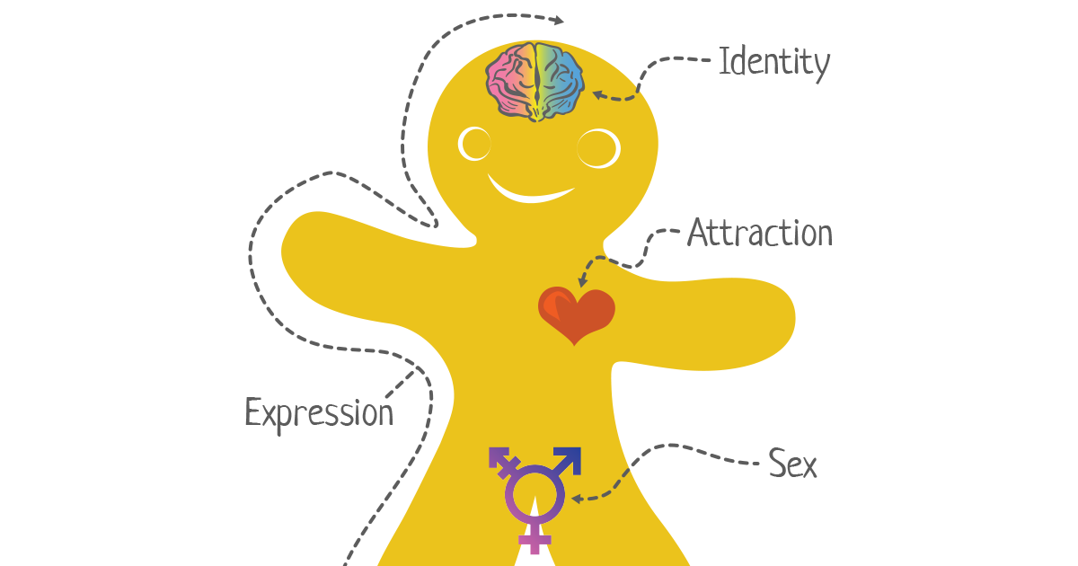
The difference between sex, sexuality, and sexuality education
Sex refers to whether or not a person is male or female.
OR to distinguish whether a person has a penis or vagina.
Sex is also commonly used as an abbreviation to refer to sexual intercourse.

Slide 4
The difference between sex, sexuality, and sexuality education
Sexuality is…
The total expression of who you are as a human being
It begins at birth and ends at our death
sexuality includes…
body image
intimacy
love
sexual orientation
gender identity
affection
values
There is no right or wrong, it’s about what’s right for you

Slide 5
The difference between sex, sexuality, and sexuality education
Sexuality Education is…
A progressive and constant learning of human sexuality;
Informing, bringing students to reflect and express themselves,
providing guidance and clear messages about sexuality and healthy relationships.

Slide 6
Comprehensive Sexuality Education

Slide 7
Why our students need to learn about sexuality
 Promoting egalitarian relationships
Preventing sexual assault
Preventing violence
Promoting a healthy body image
Respecting sexual & gender diversity
☑ Being aware of the sexualilzation of public space
Preventing STBBIs and pregnancy

Slide 8
I am able to make myself better understood if I need to report inappropriate touching to a trusted adult.
I am able to set appropriate boundaries.
I am comfortable with my body and my sexuality.
I can talk effectively with my friends, family and trusted adults about my needs and feelings.
I know my body and how it functions.
I am able to form and maintain healthy relationships.
I understand the risks, responsibilities, and consequences of sexual behavior and act responsibly.
Sexuality Education Program GOALS
I can appreciate myself as being unique.
.

Slide 9
Why students need sexuality education

Slide 10
Themes and Learning content
MEES detailed content

Slide 11
Sexual Growth and body image
Elementary:
Identifying, understanding, and becoming aware of the physical and psychological changes associated with growing up
Secondary:
Reflecting on the advantages of having a positive body image

Slide 12
Comprehensive View of Sexuality
Elementary:
Children understand what sexuality is through all dimensions
Secondary:
Adolescents are becoming aware and gradually adopting new roles and behaviors related to their sexuality
 ☑

Slide 13
Identity Gender Stereotypes and Roles, and Social Norms
Elementary:
Identifying and analyzing gender roles and stereotypes, and making connections with gender inequalities.
Secondary:
Recognizing and analyzing the role of puberty and their influence on gender identity, in the public space.
 ☑

Slide 14
Pregnancy and birth
Elementary :
Understanding the phenomenon of conception and fetal development in the uterus
STBBI’s AND PREGNANCY
Secondary:
Take responsibility of sexual and reproductive health
Identify risks of STBBI’s
Understand importance of contraception

Slide 15
Sexual Assault and sexual violence
Elementary:
To recognize different forms of sexual assault and ways of preventing and protecting themselves.
Secondary:
To reflect, understand and recognizing situations of sexual assault or sexual violence.
☑

Slide 16
sexual behavior
Secondary:
Becoming aware of factors that are important to sustaining emotional and sexual intimacy.
☑

Slide 17
Emotional and romantic life
Elementary:
Recognizing and expressing feelings, love and friendship and understanding how behaviors can affect interpersonal relationships
Secondary:
Becoming aware of the feelings of love and attraction in relationships and understanding meaningful healthy relationships


Slide 18
Roles and responsibilities
Parents or guardians responsibilities:
educating their children while respecting their values and taking their personalities into account
Children learn:
different ways of living and expressing themselves
interact with different people;
receive and express affection, love and empathy

Slide 19
Roles and responsibilities
Parent roles:
Act as models
Influence their children’s attitudes and behaviors.
Create relationships of trust that allows their children to ask questions that are of concern.
Are in a position to fulfill their role in sexuality education in a straightforward and honest manner.

Slide 20
Roles and responsibilities
School responsibilities:
provide facts
a social environment where students interact
opportunities to learn how to live in society: friendships, romantic relationships, egalitarian relationships.

Slide 21
Roles and responsibilities
Events related to students’ sexuality occur on a daily basis in schools
Wassim, a kindergarten student who has just welcomed a little brother, asks his teacher questions about where babies come from.
Maude tells her daycare educator that a student pulled his pants down in front of the other students.
Justin, an Elementary 2 student, is in love. He asks his teacher if he can have two girlfriends.

Slide 22
implementation
Students will receive 5 to 15 hours of sexuality education per year
Elementary 5-10 hours
Secondary 10-15 hours
Delivered by classroom teacher in collaboration with:
School nurse, social worker,
Board professional; guidance counselor, spiritual animator , psychologist,
Community organizations

Slide 23
Gradual implementation
Program will be taught between February and June.
Parents and Governing Board shall be informed of themes and learning content through correspondence from the school.
Governing board will be informed about the details of implementation.
The Sexuality Education Curriculum Plan will be shared with all parents.
Sexuality Education Curriculum Plan

Slide 24
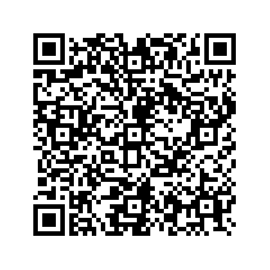
Learning content in sexuality education

